Slide 1
INTRODUCTION TO TREES FOREST AND TRUST RELATIONSHIP IN ACTIVE DIRECTORY
PRESENTED BY
GOKUL MANI S

Slide 2
ACTIVE DIRECTORY
Active Directory (AD) is a database and set of services that connect users with the network resources they need to get their work done
The database (or directory) contains critical information about your environment, including what users and computers there are and who's allowed to do what

Slide 3
DOMAINS
The server responsible for managing network and identity security requests
It acts as a gatekeeper and authenticates whether the user is authorized to access the IT resources in the domain

Slide 4
TREES
These parent-child domain relationships form a domain tree
Domains in a tree are joined by transitive trusts
A tree is a contigouos name space

Slide 5
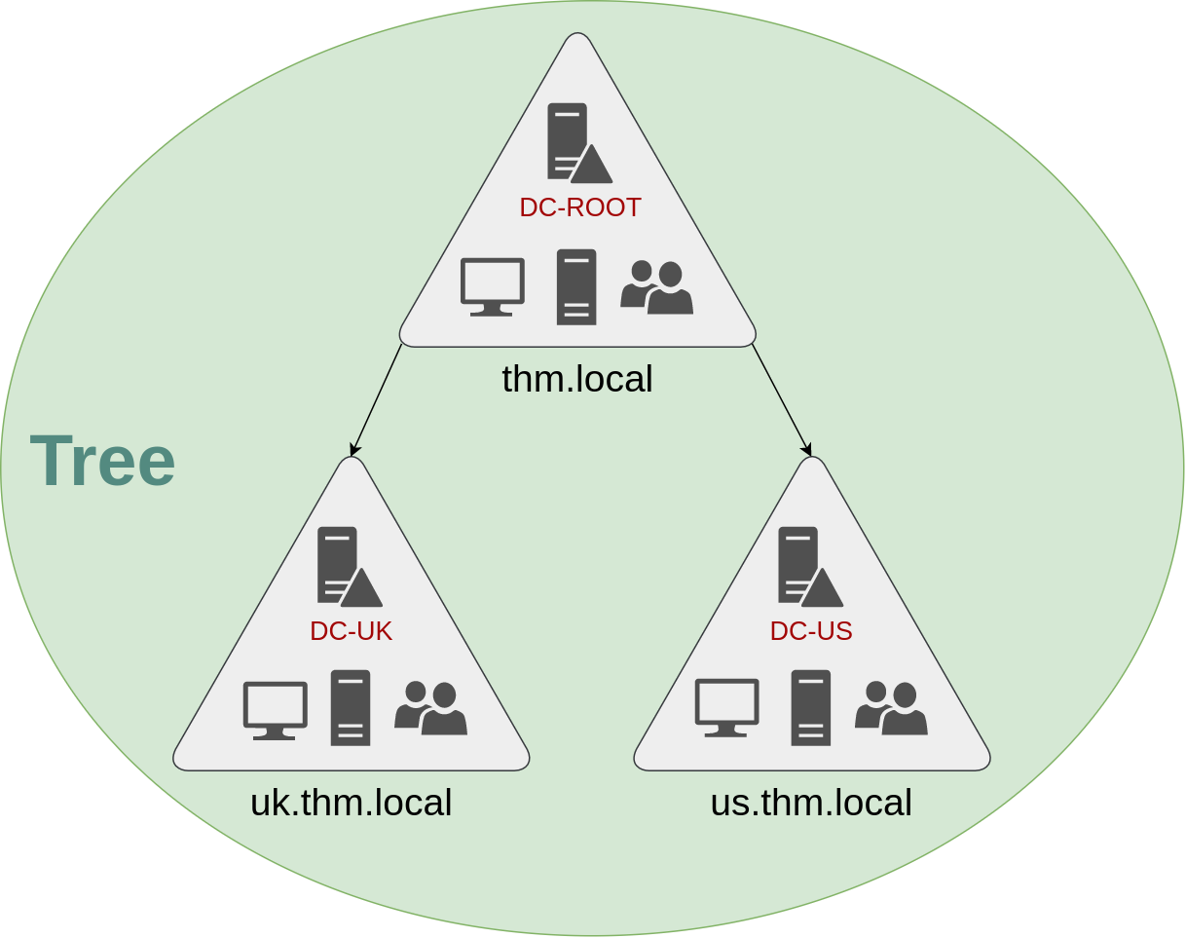

Slide 6
FORESTS
Domain trees can be joined at the root to form a domain forest
The root domains are joined via transitive trust
Every domain in a forest implicitly trusts every other

Slide 7
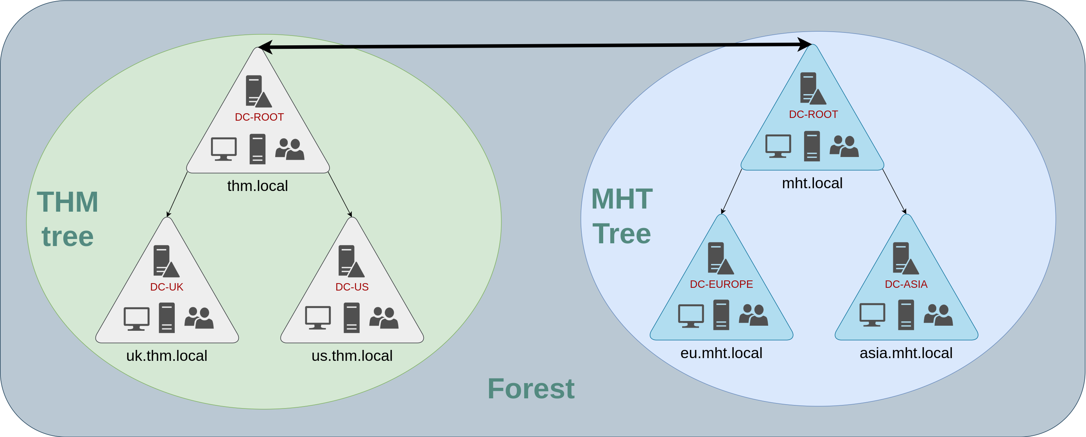

Slide 8
TRUST RELATIONSHIP
Multiple domains organised in trees and forest allows you to have a nice compartmentalised network in terms of management and resources
Trust relationship between domains allows you to authorise a user from domain THM UK to access resources from domain MHT EU

Slide 9
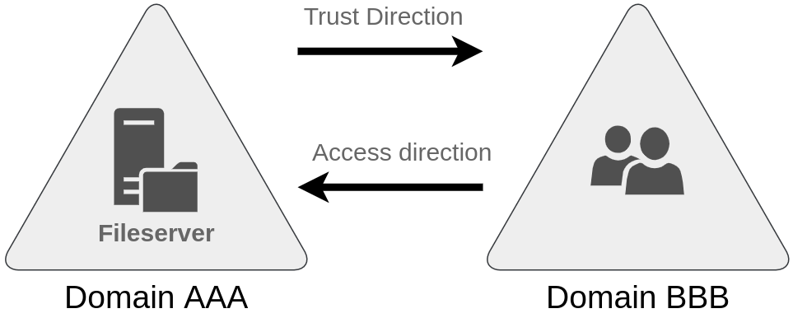

Slide 10
TWO TYPES OF TRUST RELATIONSHIP
ONE WAY TRUST RELATIONSHIP
TWO WAY TRUST RELATIONSHIP

Slide 11
ONE WAY TRUST RELATIONSHIP
A unidirectional authentication path created between two domains
In a one-way trust between Domain A and Domain B, users in Domain A can access resouces in Domain B.

Slide 12
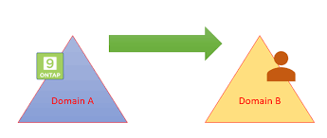

Slide 13
TWO WAY TRUST RELATIONSHIP
Two-way trust relationships can also be made to allow both domains to mutually authorise users from the other.
Authentication requests can be passed between the two domains in both directions

Slide 15
THANK YOU

